Slide 1



Concert Ticket Service
Andrea Manini
Matricola: 995318
Person code: 10610146
Academic year: 2023 – 2024
A Performance Evaluation and Application project

Slide 2

Aim of the project
The aim of the project is to create a model of a concert ticketing service, in which welcomed customers can select a seat for their favorite concert and buy the corresponding ticket.

Slide 3
Aim of the project
We can consider the concert ticketing service as composed of four stages:
Welcome message
Seat selection
Payment processor
Ticket issuing
Welcome message
Seat selection
Payment processor
Ticket issuing

Slide 4
Aim of the project
We can consider the concert ticketing service as composed of four stages:
Welcome message
Seat selection
Payment processor
Ticket issuing
Welcome message
Seat selection
Payment processor
Ticket issuing

Slide 5
Aim of the project
We can consider the concert ticketing service as composed of four stages:
Welcome message
Seat selection
Payment processor
Ticket issuing
Welcome message
Seat selection
Payment processor
Ticket issuing

Slide 6
Aim of the project
We can consider the concert ticketing service as composed of four stages:
Welcome message
Seat selection
Payment processor
Ticket issuing
Welcome message
Seat selection
Payment processor
Ticket issuing

Slide 7
Aim of the project
We can consider the concert ticketing service as composed of four stages:
Welcome message
Seat selection
Payment processor
Ticket issuing
Welcome message
Seat selection
Payment processor
Ticket issuing

Slide 8



Aim of the project
We can consider the concert ticketing service as composed of four stages:
Welcome message
Seat selection
Payment processor
Ticket issuing
Welcome message
Seat selection
Payment processor
Ticket issuing

Slide 9
Before modeling… assumptions!
The following assumptions have been made, in according to our understanding of the text:
1
The ‘pending’ requests are considered as the whole number of customers contained in the system, considering both the customers waiting in the queues and the ones being served.
All measurement units are in seconds.
Non-admitted customers are the ones which have not been allowed to ‘read’ the welcome message. Thus, they will not even enter the system.
2
3

Slide 10
Building the model
Since new customers can arrive inside the system to buy a ticket, we decided to use an open model.
Furthermore, the four stages have been modeled as single, multiple-server queuing stations servicing the customers.
Hence, the final model resulted in a single class, open queuing network created using JMT’s tool JSIMGraph.

Slide 11
Building the model
Since new customers can arrive inside the system to buy a ticket, we decided to use an open model.
Furthermore, the four stages have been modeled as single, multiple-server queuing stations servicing the customers.
Hence, the final model resulted in a single class, open queuing network created using JMT’s tool JSIMGraph.
WHY?

Slide 12
Building the model
Since new customers can arrive inside the system to buy a ticket, we decided to use an open model.
Furthermore, the four stages have been modeled as single, multiple-server queuing stations servicing the customers.
Hence, the final model resulted in a single class, open queuing network created using JMT’s tool JSIMGraph.
The system is not separable since the following assumptions are violated:
Service center flow balance: losses may occur due to the finite capacity of the system.
Homogeneous external arrivals: the arrivals are generated in a source which exhibits bursts (MMPP(2)).
Service time homogeneity: the model is built using multiple-server queuing stations.
Hence, direct solutions may not be applied and thus we base our solution on discrete event simulation.

Slide 13
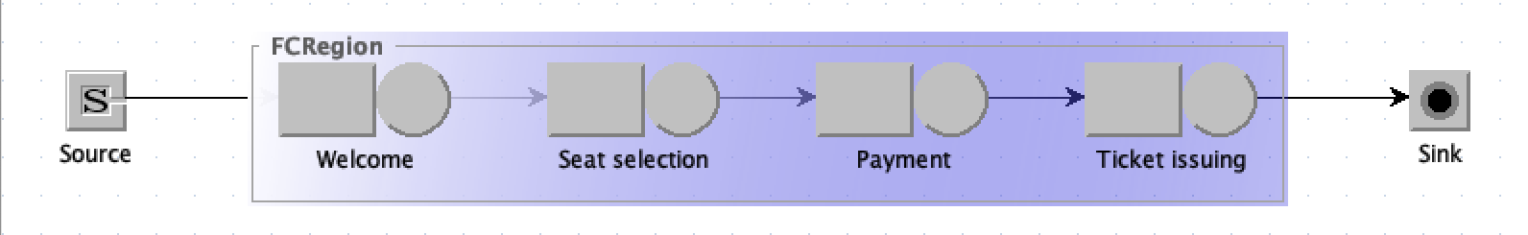
Building the model
Since new customers can arrive inside the system to buy a ticket, we decided to use an open model.
Furthermore, the four stages have been modeled as single, multiple-server queuing stations servicing the customers.
Hence, the final model resulted in a single class, open queuing network created using JMT’s tool JSIMGraph.

Slide 14
Description of the model: the source
Since new customers can arrive inside the system to buy a ticket, we decided to use an open model.
Furthermore, the four stages have been modeled as single, multiple-server queuing stations servicing the customers.
Hence, the final model resulted in a single class, open queuing network created using JMT’s tool JSIMGraph.
MMPP(2)

Slide 15
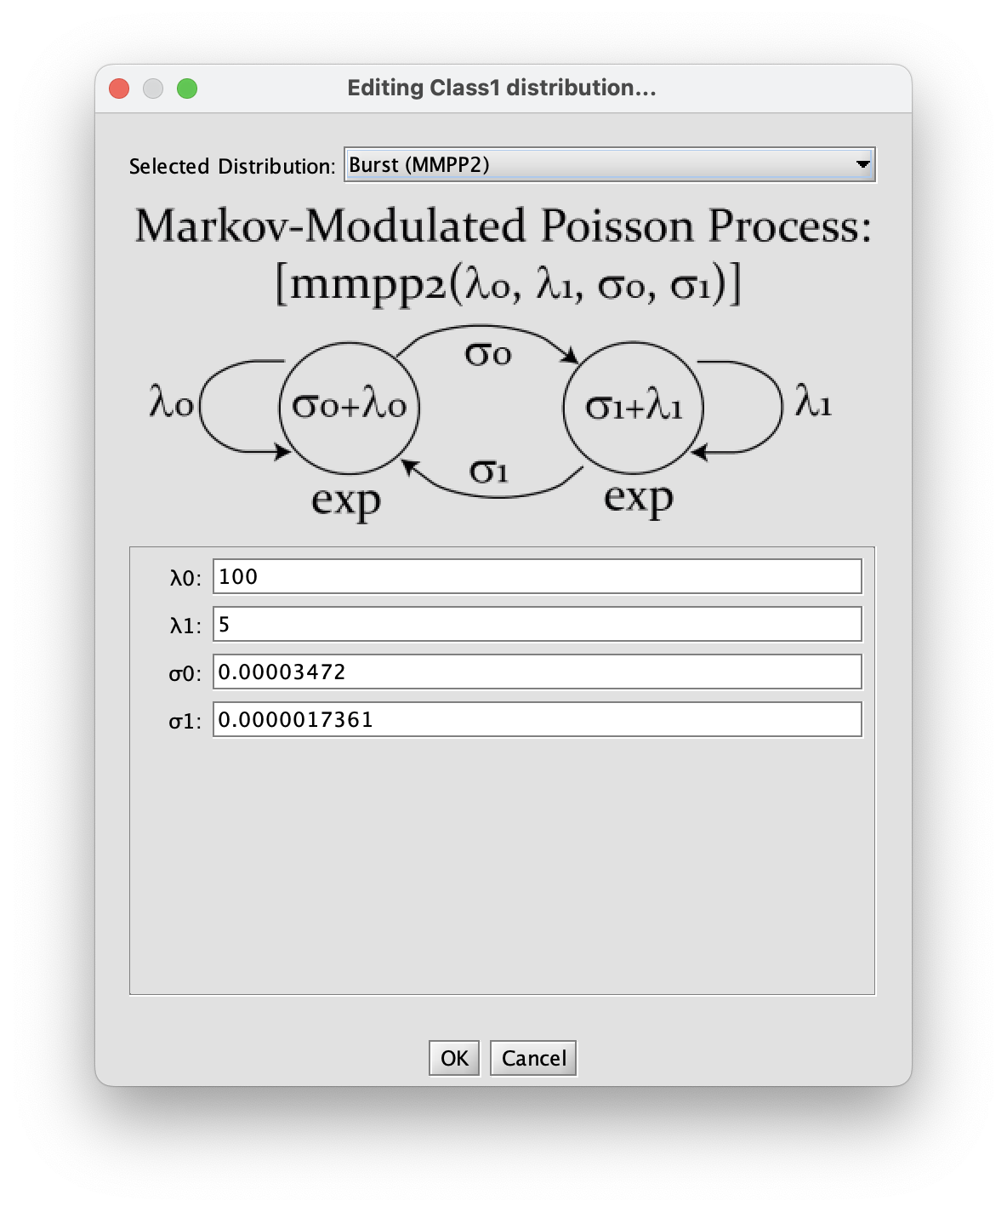
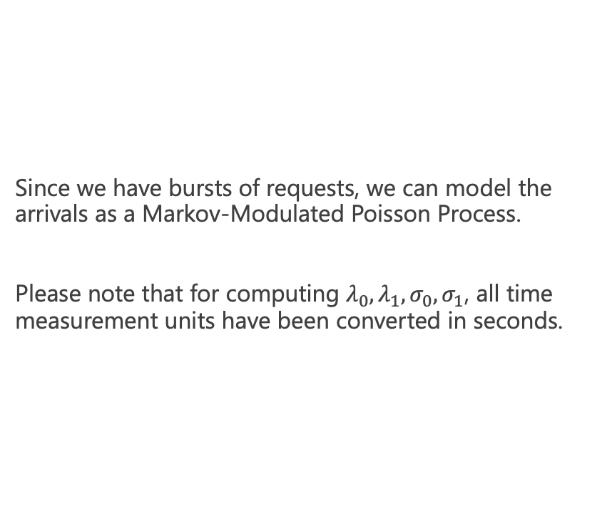
The source: in-depth description
Since we have bursts of requests, we can model the arrivals as a Markov-Modulated Poisson Process.
Please note that for computing $λ_{0}, λ_{1}, σ_{0}, σ_{1}$, all time measurement units have been converted in seconds.

Slide 16
Description of the model: the stations
Since new customers can arrive inside the system to buy a ticket, we decided to use an open model.
Furthermore, the four stages have been modeled as single, multiple-server queuing stations servicing the customers.
Hence, the final model resulted in a single class, open queuing network created using JMT’s tool JSIMGraph.
Erlang
Exponential
Exponential
Hyper-Exponential
Number of servers:
1
19
4
4
Queuing policy:
FCFS
FCFS
FCFS
FCFS
Notes:
Fai un discorso sul sistema con 1 server per stazione e menziona come hai usato l’utilization per giostrare il numero di server: hai scelto di aumentare i server nelle stazioni con utilization più elevata. Hai anche provato a fare salire il numero di server nella stazione 1, ma così veniva una utilization talmente bassa che il drop rate ne veniva penalizzato, siccome molti job potevano arrivare ma il limite veniva raggiunto alla svelta. Poi menziona che cambiando il numero di server della stazione 2 hai dovuto aggiustare anche il numero delle altre (la 3 e la 4).

Slide 17
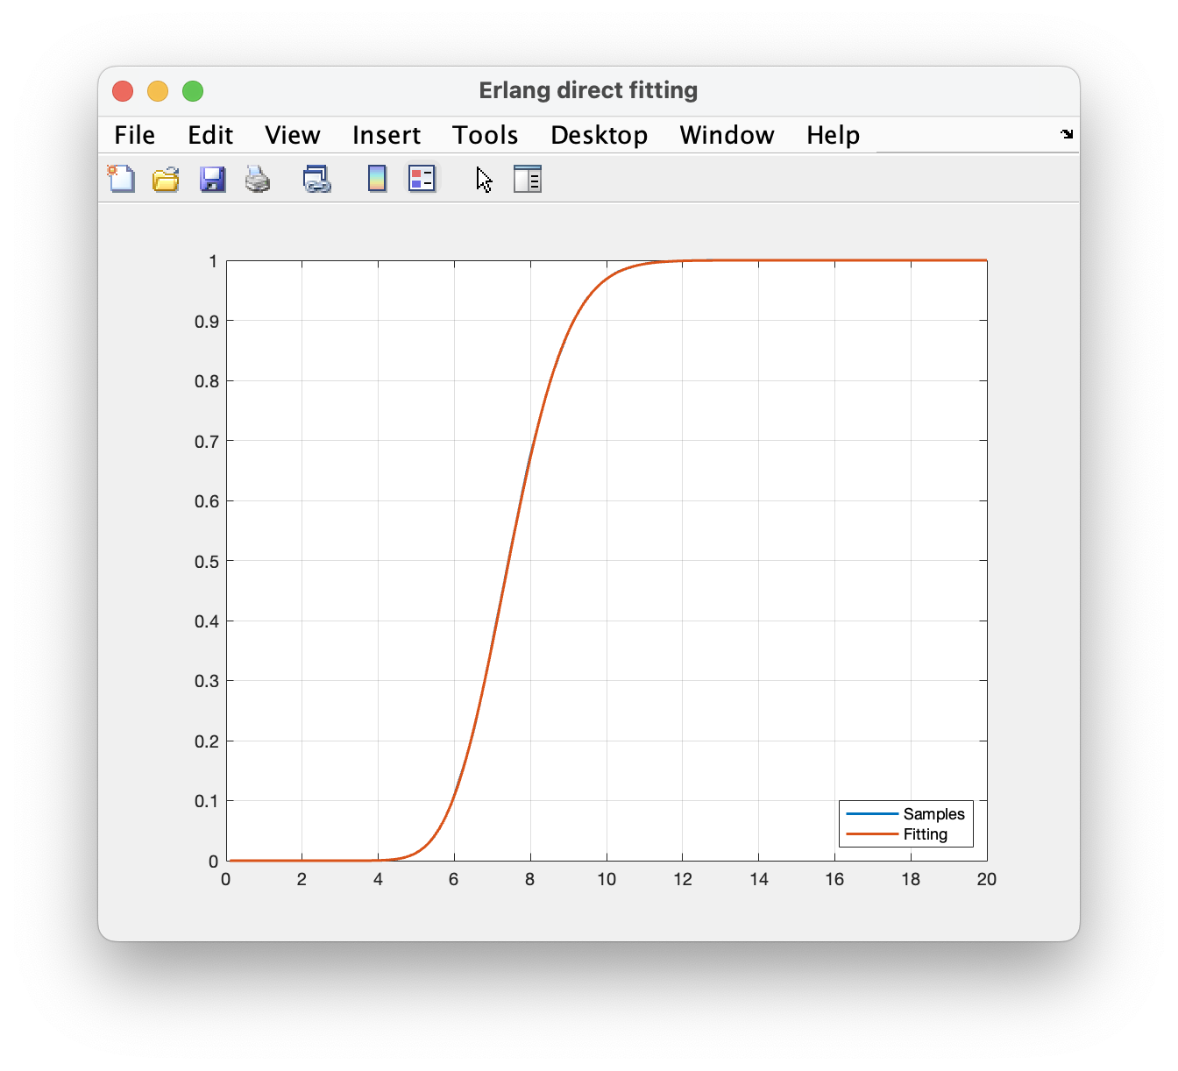
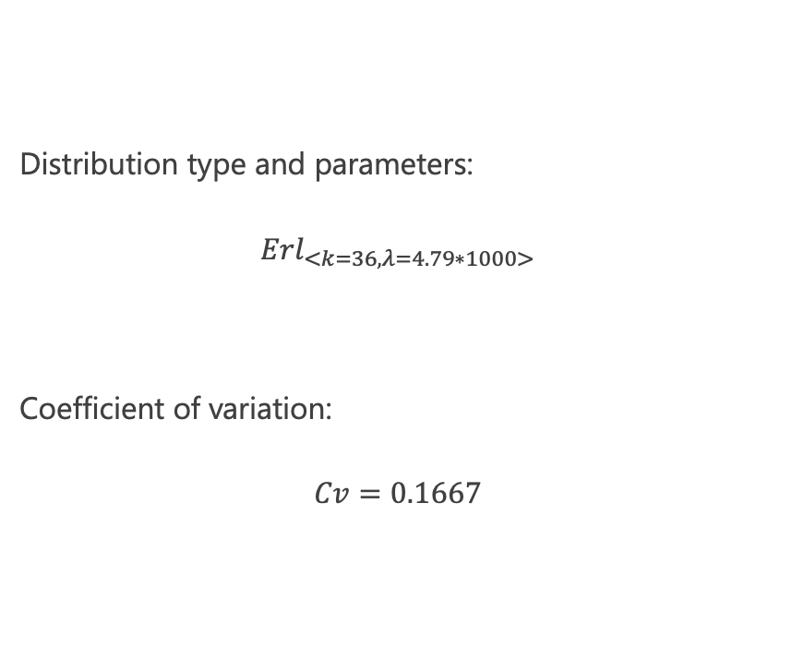
Fitting the distributions: Welcome station
Distribution type and parameters:
$${Erl}_{<k=36, λ=4.79∗1000>}$$
Coefficient of variation:
$$Cv=0.1667$$

Slide 18
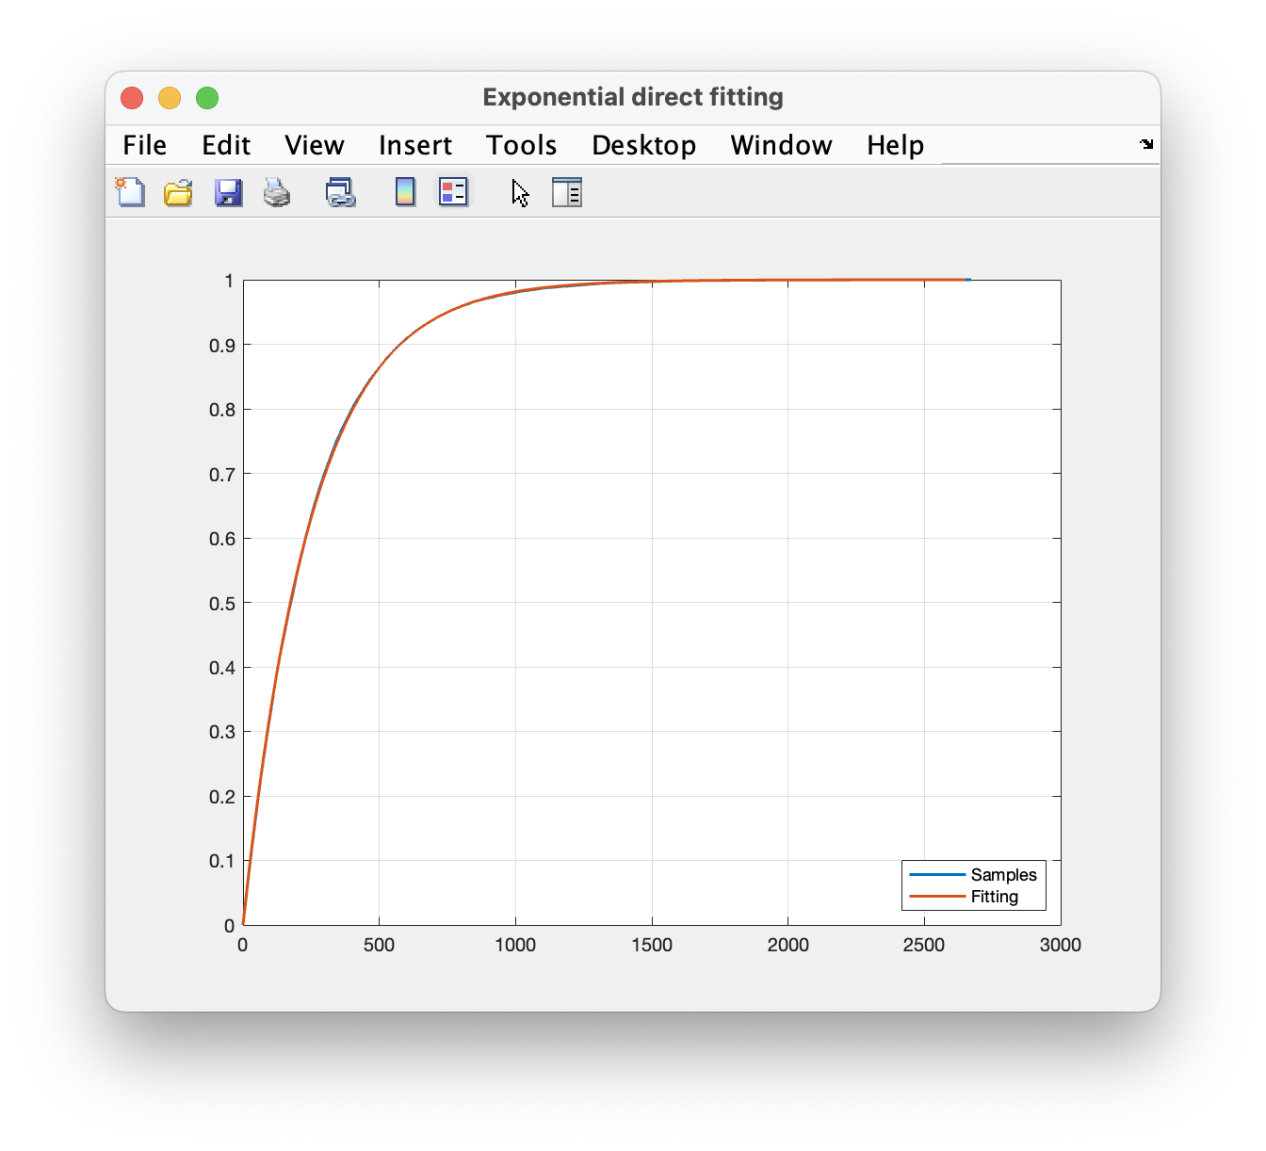

Fitting the distributions: Seat selection station
Distribution type and parameters:
$${Exp}_{<λ=0.0039854∗1000>}$$
Coefficient of variation:
$$Cv=1.0052$$

Slide 19
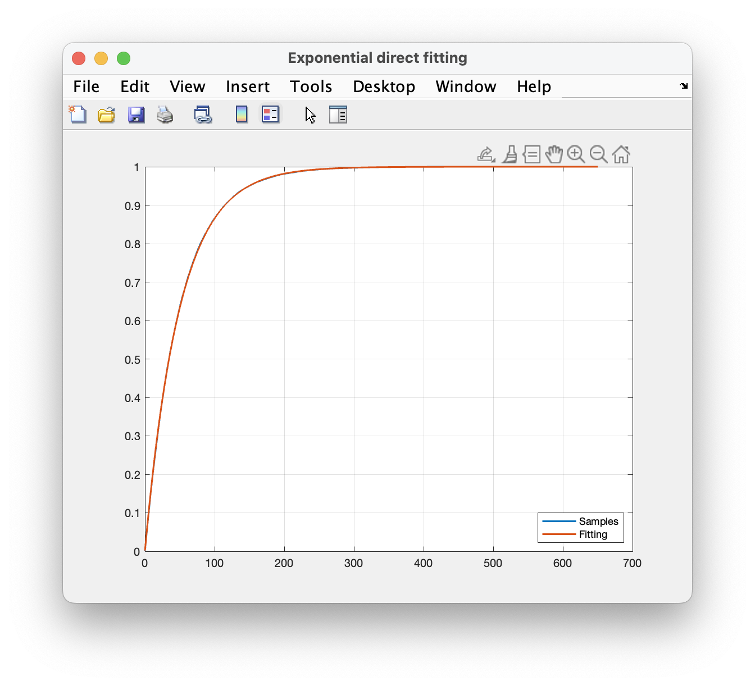
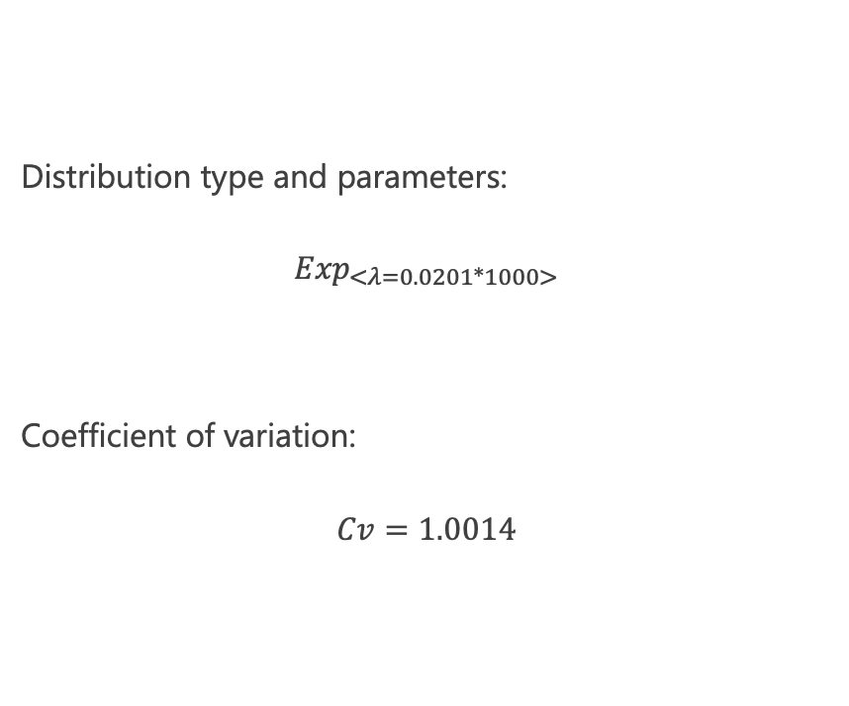
Fitting the distributions: Payment station
Distribution type and parameters:
$${Exp}_{<λ=0.0201∗1000>}$$
Coefficient of variation:
$$Cv=1.0014$$

Slide 20
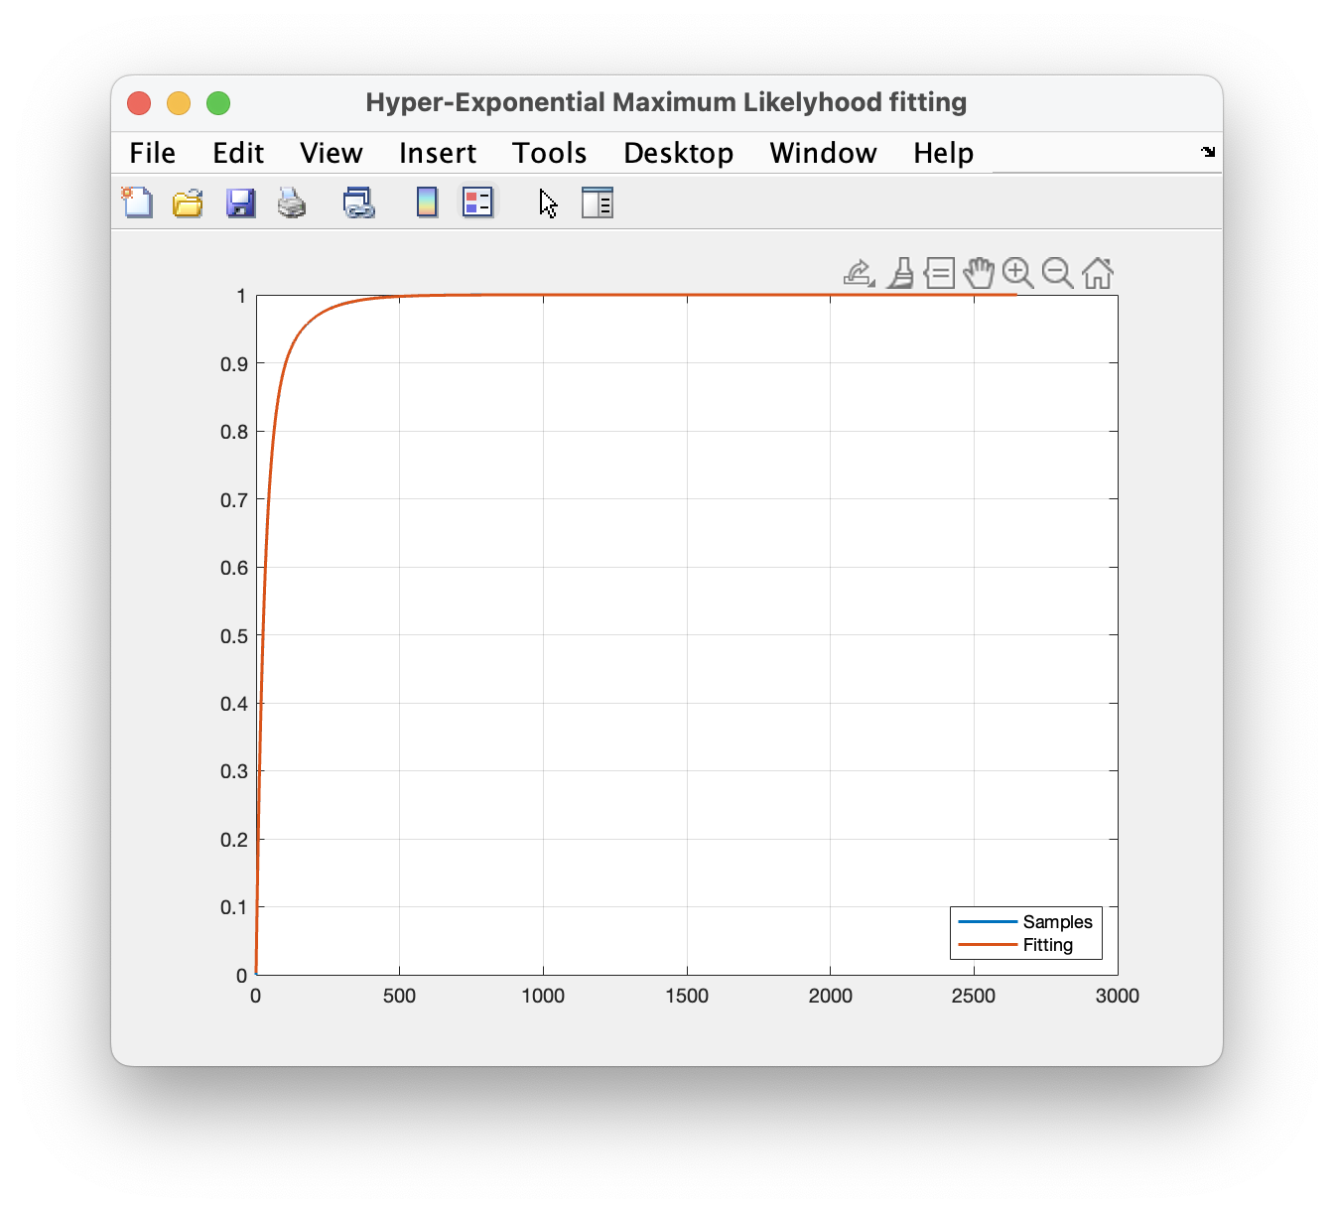
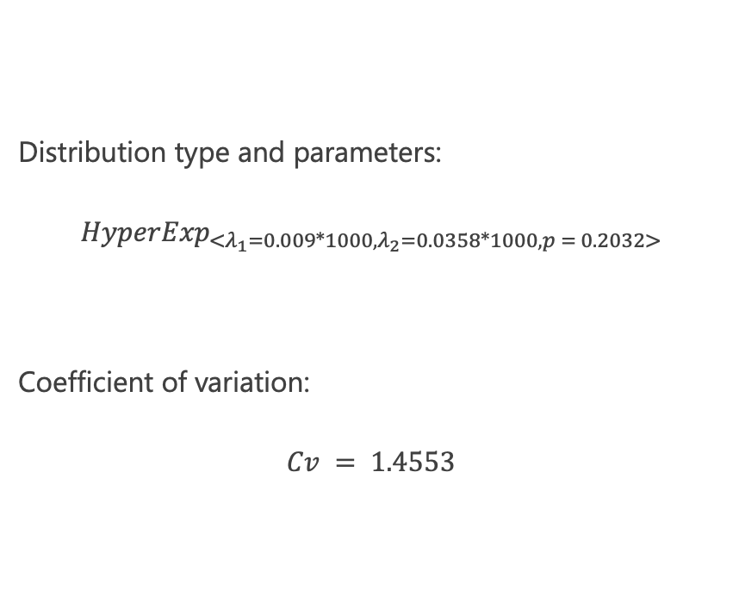
Fitting the distributions: Ticket issuing station
Distribution type and parameters:
$${HyperExp}_{<λ_{1}=0.009∗1000, λ_{2}=0.0358∗1000,p = 0.2032>}$$
Coefficient of variation:
$$Cv = 1.4553$$

Slide 21
Description of the model: the Finite Capacity Region
Since new customers can arrive inside the system to buy a ticket, we decided to use an open model.
Furthermore, the four stages have been modeled as single, multiple-server queuing stations servicing the customers.
Hence, the final model resulted in a single class, open queuing network created using JMT’s tool JSIMGraph.
FCR

Slide 22
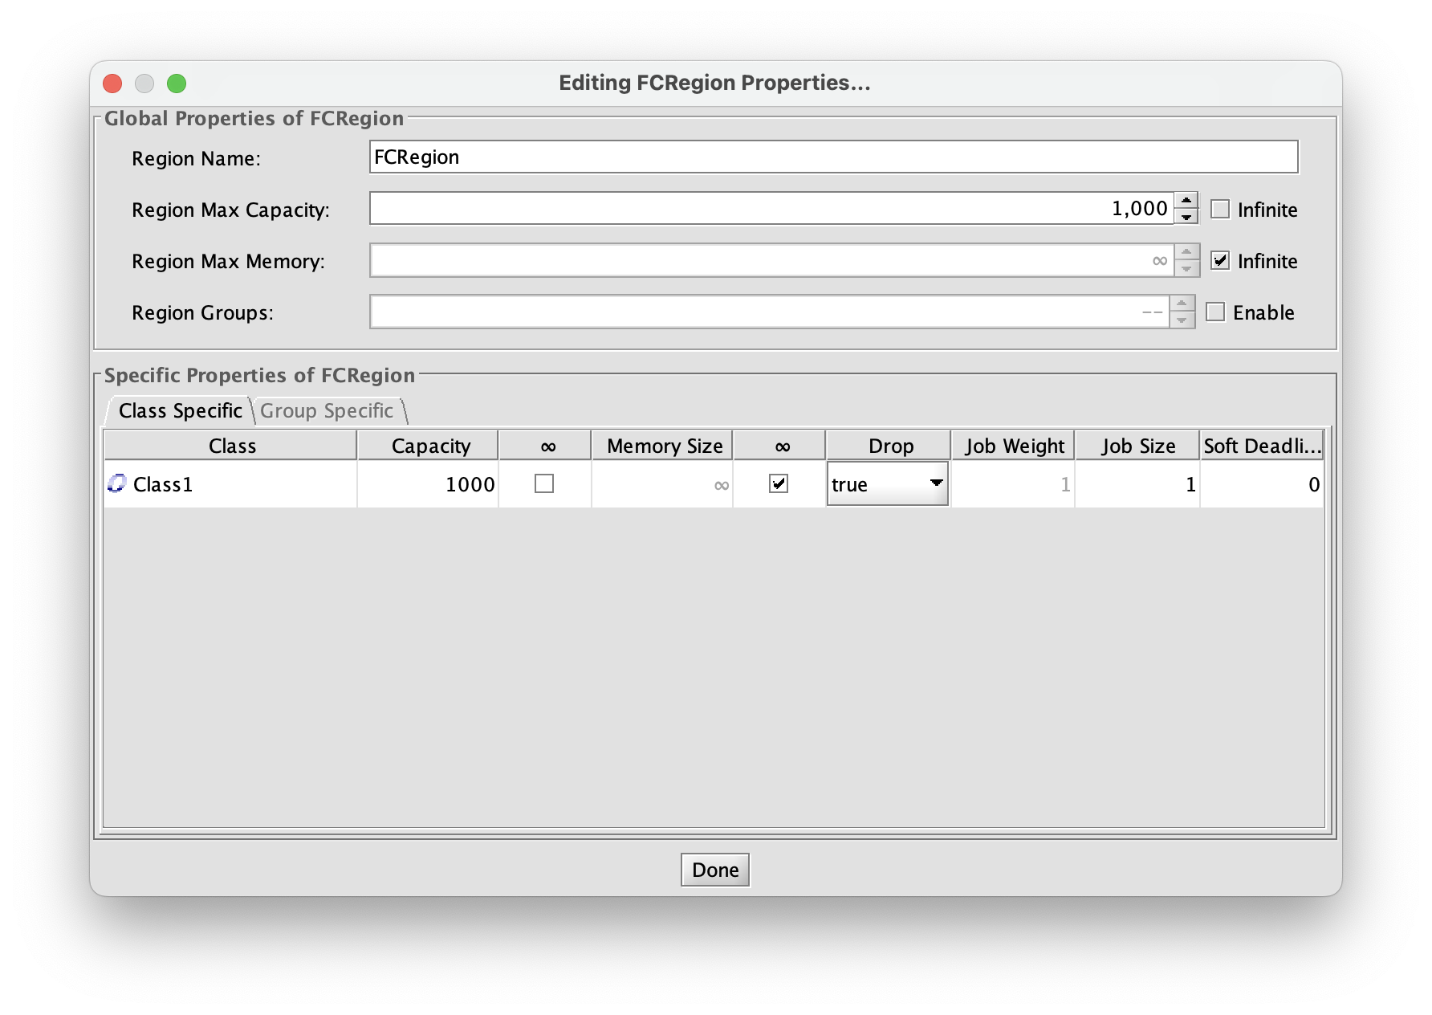
The FCR: in-depth description
The Finite Capacity Region has been set up to allow a maximum of N = 1000 customers inside the system.
The ‘drop’ option has also been set to true.

Slide 23
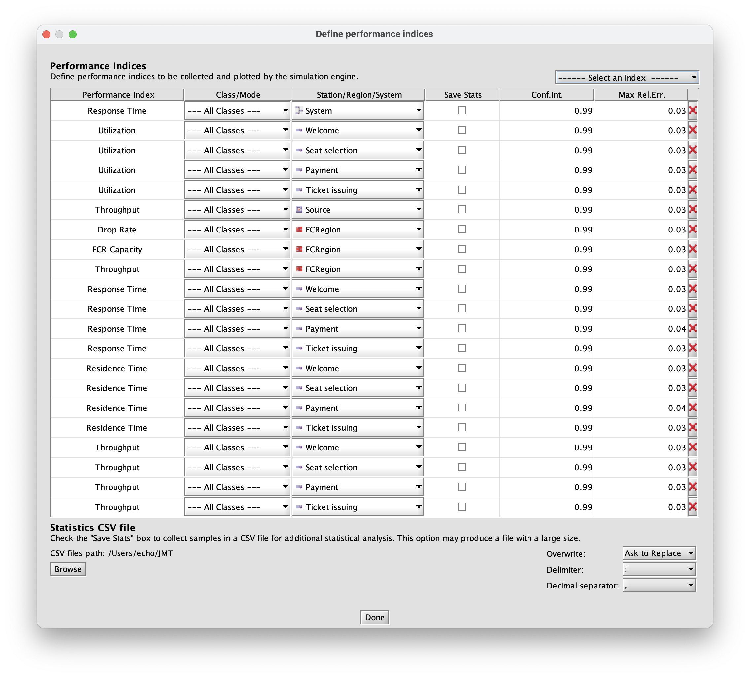
Measuring performance: defining performance indices
The following performance indices has been defined:
Notes:
Gli arrival rate li hai usati insieme alle utilization per vedere come variava la frequenza di arrivo dei job alle stazioni in base al numero di server scelto per stazione.

Slide 24
Measuring performance: defining performance indices
The following performance indices has been defined:
We will now focus on these ones
Notes:
Le utilization per vedere come variava la frequenza di arrivo dei job alle stazioni in base al numero di server scelto per stazione.

Slide 25
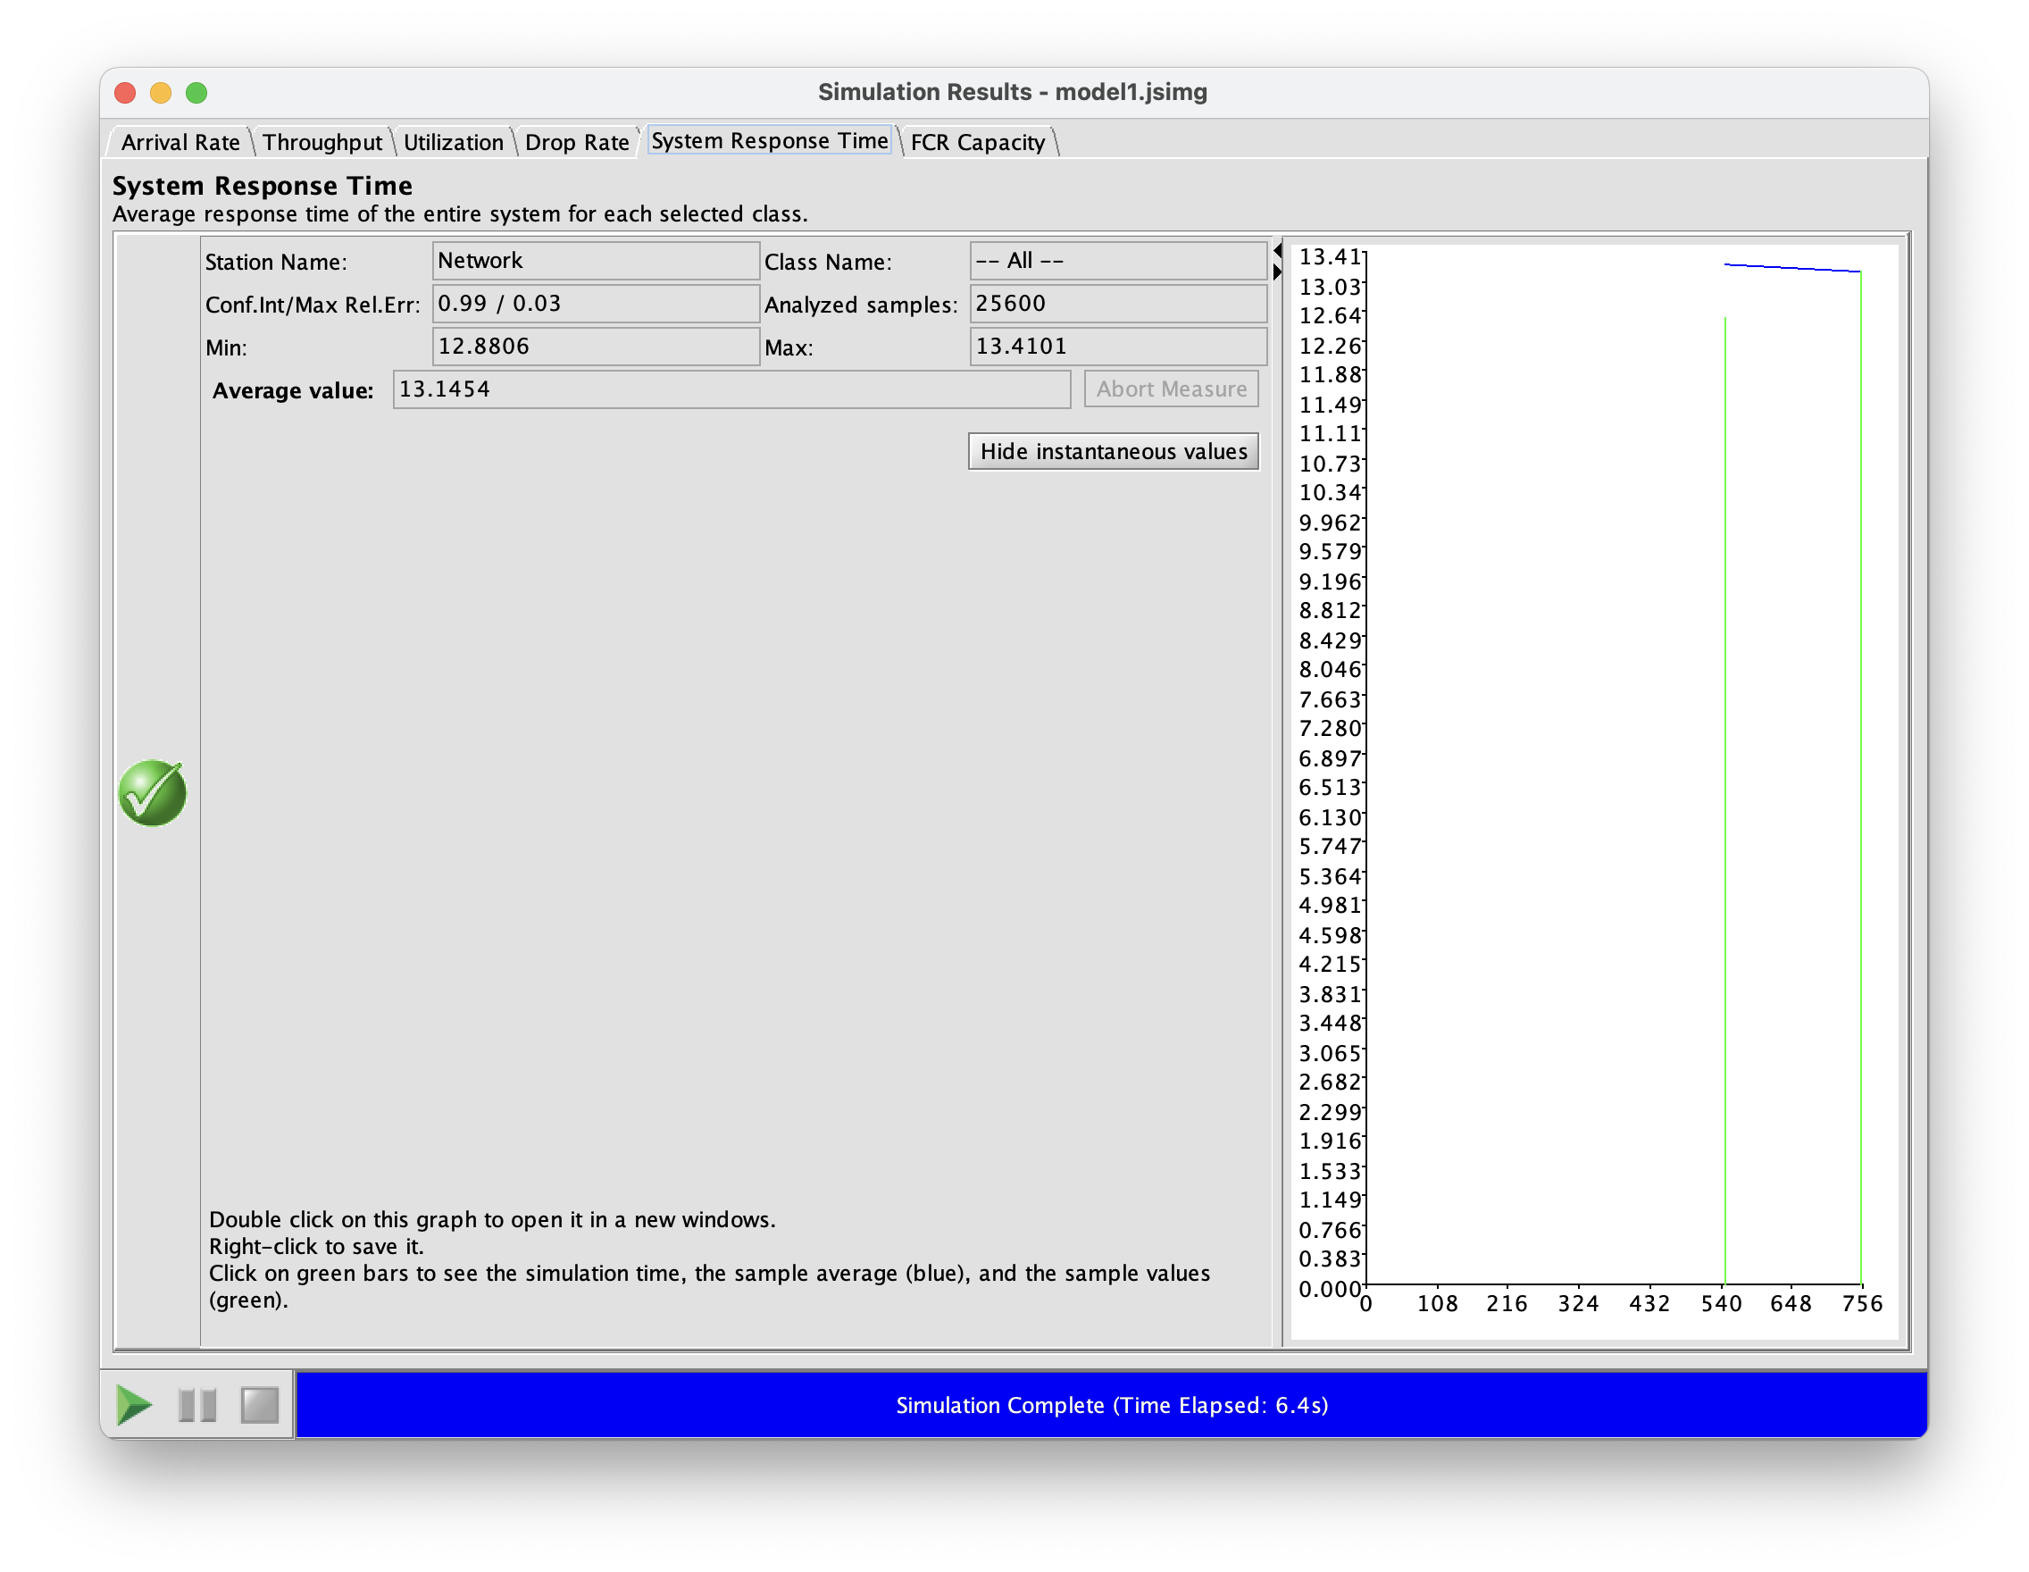
System’s response time
The following is the obtained system’s average response time.
Since every time measurement unit has been converted in seconds, the target performance required it to be under the limit of 5 min = 300 s.
With an average of R = 13.1454 s, we have great margin under the target limit.

Slide 26
An interlude: deriving the drop probability formula
The new desired performance index to determine is the drop probability, but JMT only allows to compute the drop rate. Hence, the drop probability formula has first to be formally derived.

Slide 27
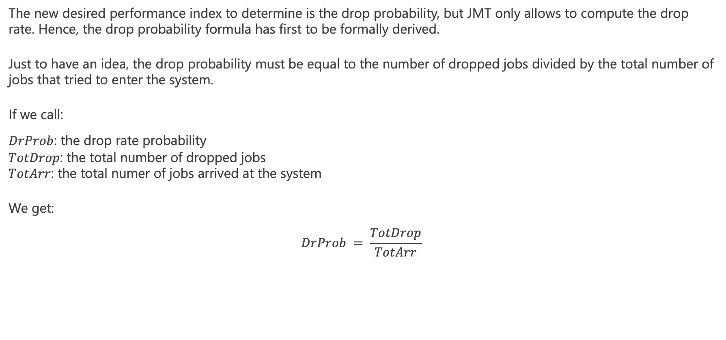
An interlude: deriving the drop probability formula
The new desired performance index to determine is the drop probability, but JMT only allows to compute the drop rate. Hence, the drop probability formula has first to be formally derived.
Just to have an idea, the drop probability must be equal to the number of dropped jobs divided by the total number of jobs that tried to enter the system.
If we call:
$DrProb$: the drop rate probability
$TotDrop$: the total number of dropped jobs
$TotArr$: the total numer of jobs arrived at the system
We get:
$$DrProb = \frac{TotDrop}{TotArr}$$

Slide 28
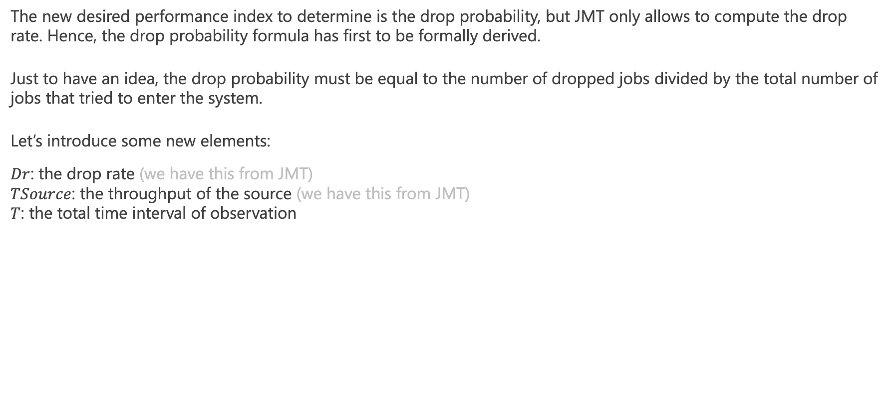
An interlude: deriving the drop probability formula
The new desired performance index to determine is the drop probability, but JMT only allows to compute the drop rate. Hence, the drop probability formula has first to be formally derived.
Just to have an idea, the drop probability must be equal to the number of dropped jobs divided by the total number of jobs that tried to enter the system.
Let’s introduce some new elements:
$Dr$: the drop rate (we have this from JMT)
$TSource$: the throughput of the source (we have this from JMT)
$T$: the total time interval of observation

Slide 29
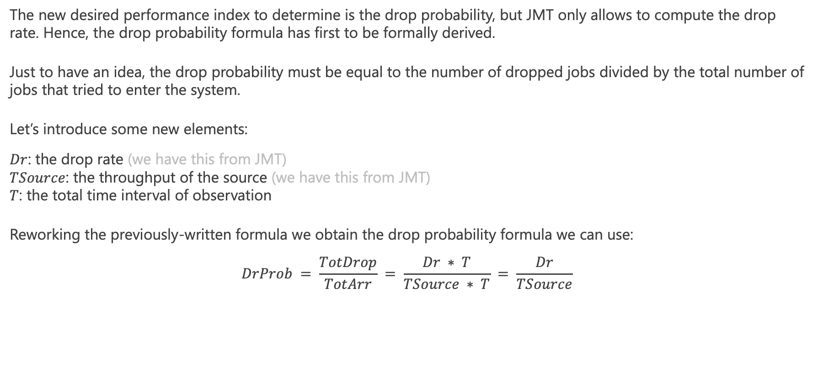
An interlude: deriving the drop probability formula
The new desired performance index to determine is the drop probability, but JMT only allows to compute the drop rate. Hence, the drop probability formula has first to be formally derived.
Just to have an idea, the drop probability must be equal to the number of dropped jobs divided by the total number of jobs that tried to enter the system.
Let’s introduce some new elements:
$Dr$: the drop rate (we have this from JMT)
$TSource$: the throughput of the source (we have this from JMT)
$T$: the total time interval of observation
Reworking the previously-written formula we obtain the drop probability formula we can use:
$$DrProb = \frac{TotDrop}{TotArr} = \frac{Dr ∗ T}{TSource ∗ T} = \frac{Dr}{TSource}$$

Slide 30
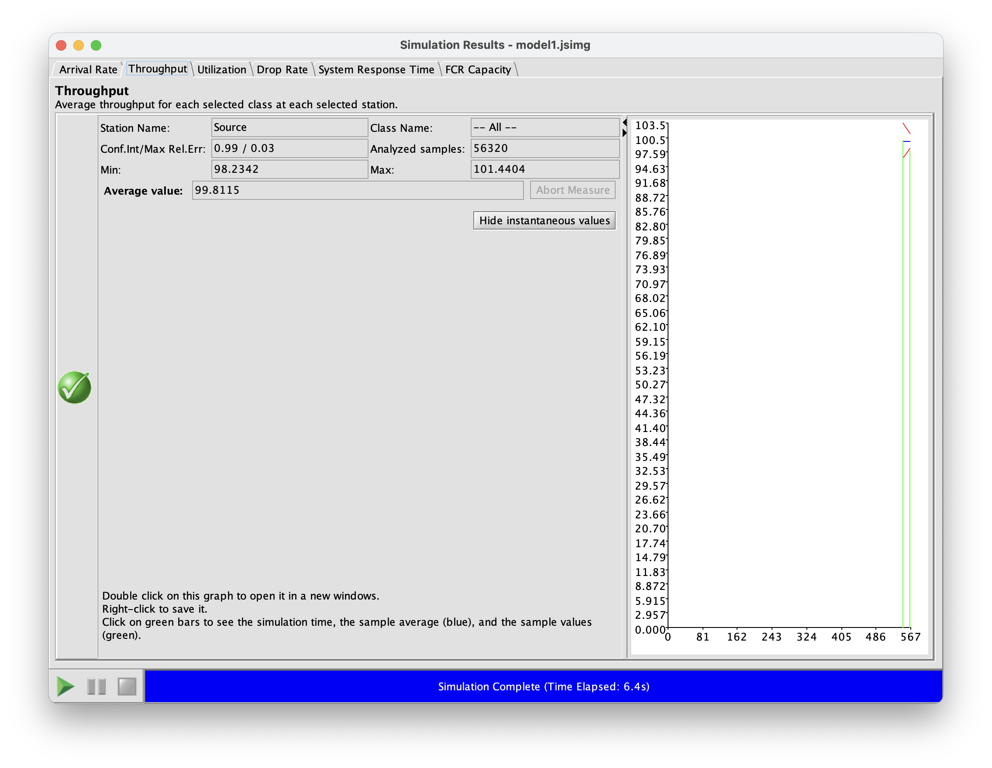

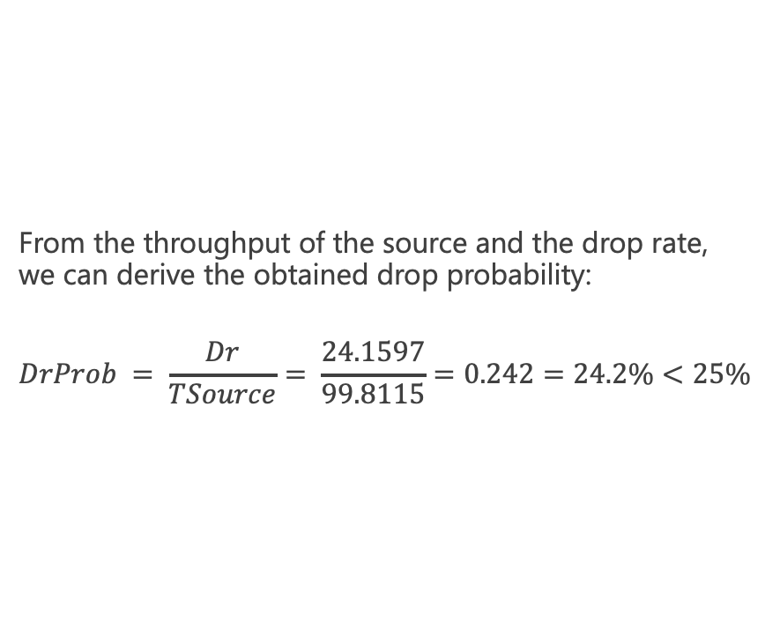
System’s drop probability
From the throughput of the source and the drop rate, we can derive the obtained drop probability:
$$DrProb = \frac{Dr}{TSource}= \frac{24.1597}{99.8115}=0.242=24.2\%<25\%$$

Slide 31
Further analyses
The following performance indices has been defined:
We will now focus on these ones
Notes:
Le utilization per vedere come variava la frequenza di arrivo dei job alle stazioni in base al numero di server scelto per stazione.

Slide 32
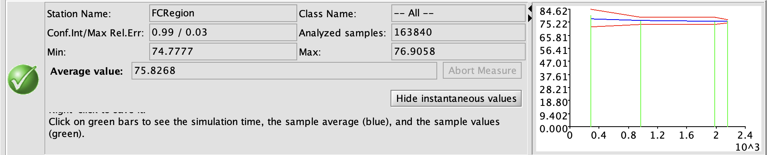
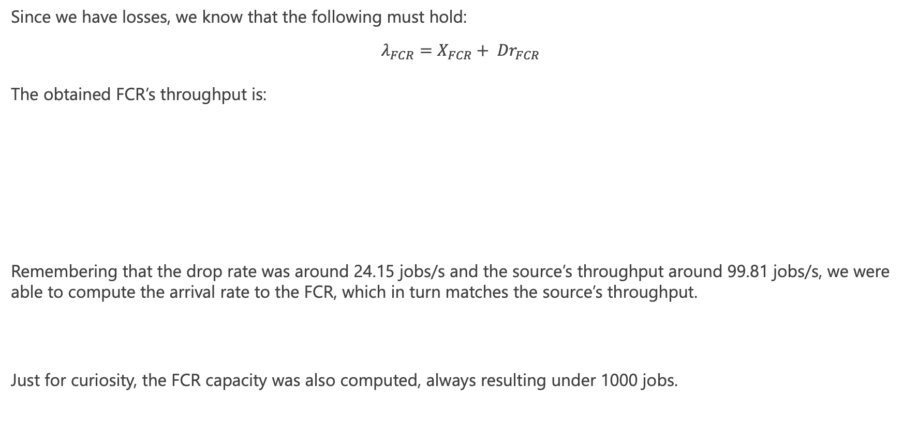
Why does it make sense to use source’s throughput?
Since we have losses, we know that the following must hold:
$$λ_{FCR}=X_{FCR}+ {Dr}_{FCR}$$
The obtained FCR’s throughput is:
Remembering that the drop rate was around 24.15 jobs/s and the source’s throughput around 99.81 jobs/s, we were able to compute the arrival rate to the FCR, which in turn matches the source’s throughput.
Just for curiosity, the FCR capacity was also computed, always resulting under 1000 jobs.

Slide 33
Further analyses
The following performance indices has been defined:
We will now focus on these ones
Notes:
Le utilization per vedere come variava la frequenza di arrivo dei job alle stazioni in base al numero di server scelto per stazione.

Slide 34
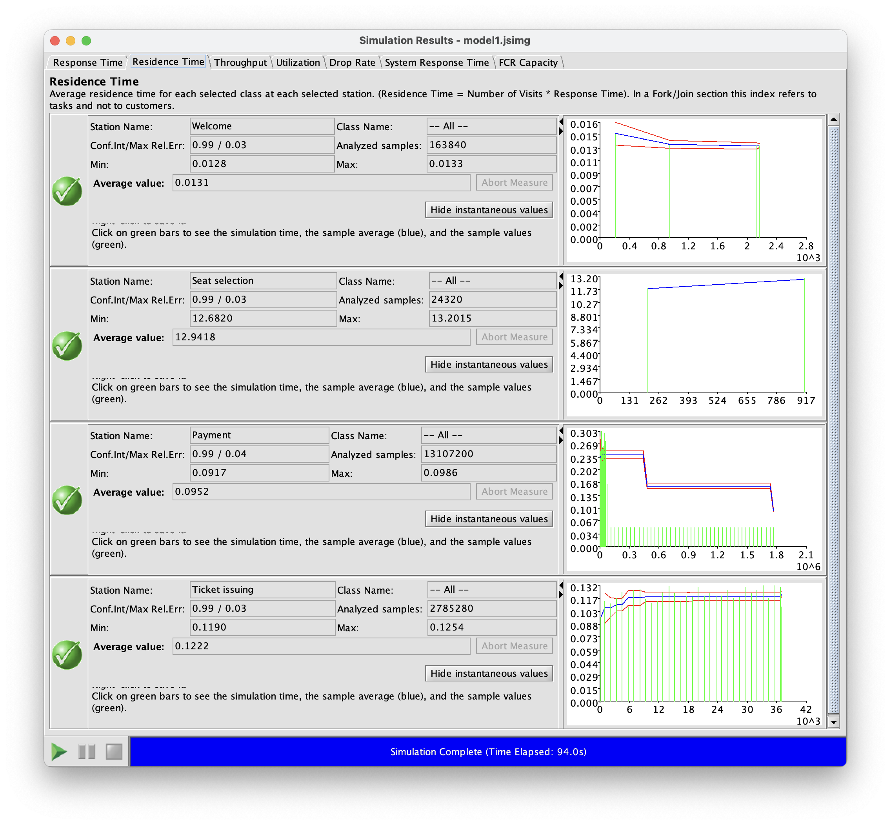
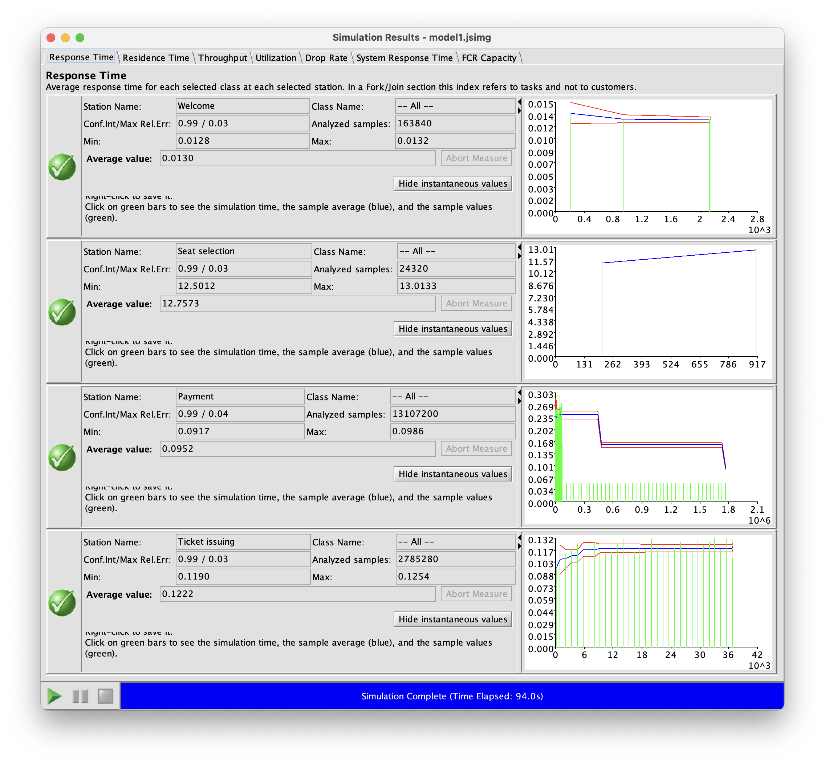
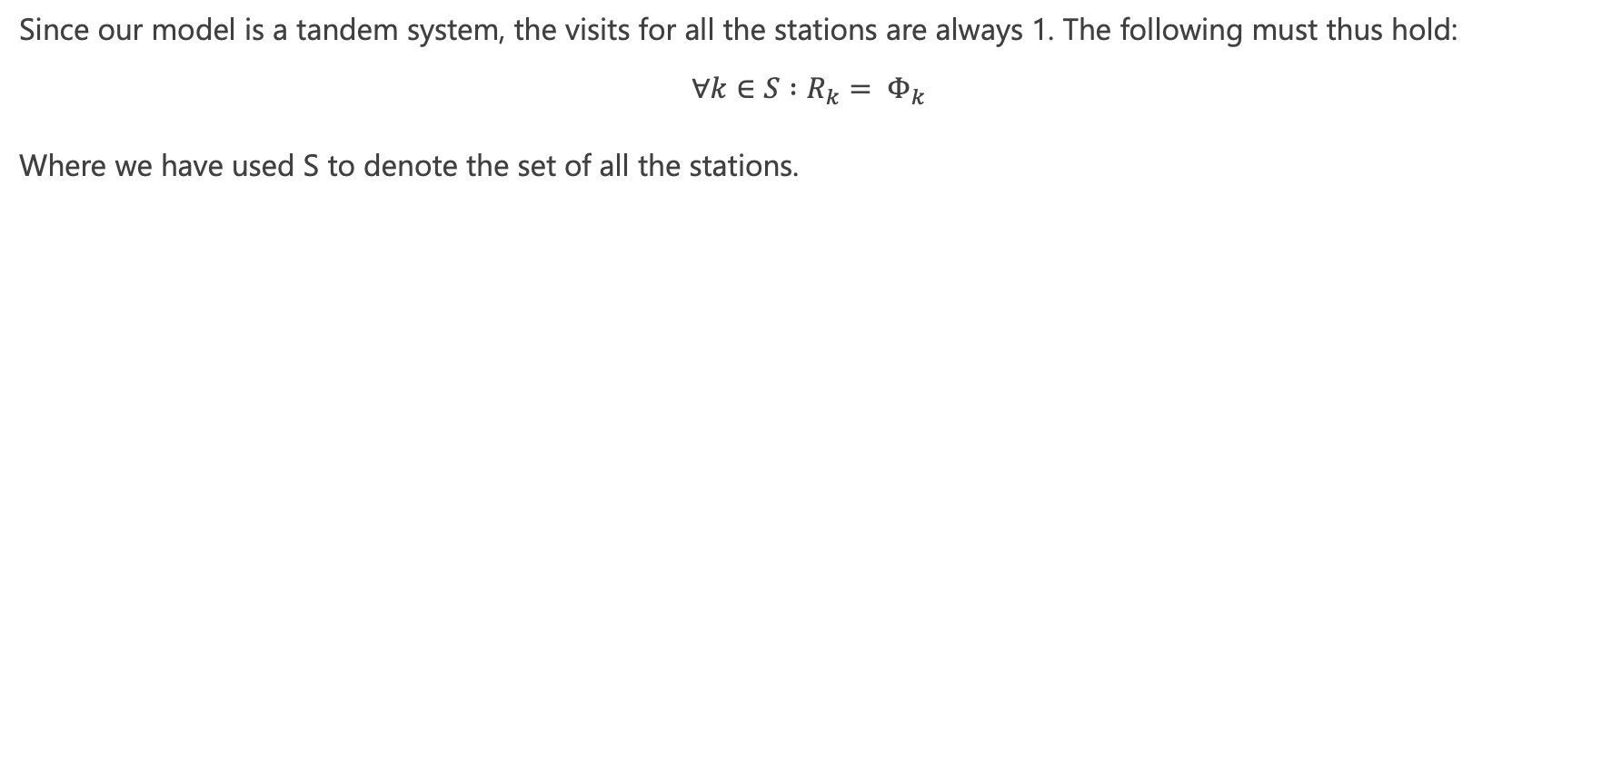
A couple of words on visits…
Since our model is a tandem system, the visits for all the stations are always 1. The following must thus hold:
$$∀k∈S :R_{k}= Φ_{k}$$
Where we have used S to denote the set of all the stations.
Residence times
Response times

Slide 35
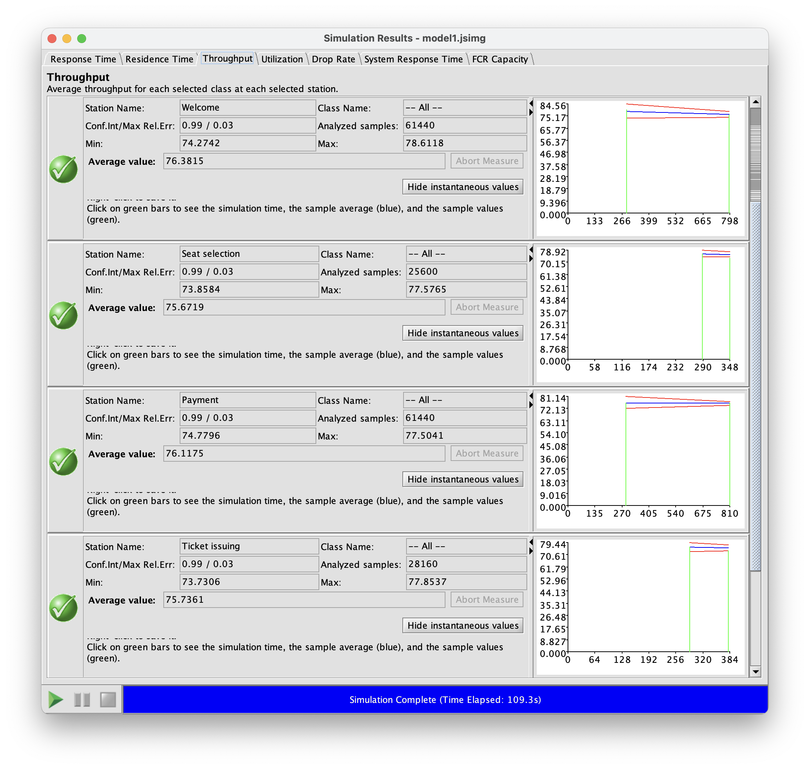
A couple of words on visits…
Due to the forced flaw law ($X_{k}= V_{k}∗X$) and due to the system being a tandem system with visits equal to 1 for all stations, we can prove that the throughput of each station is equal to the throughput of the FCR.
Stations throughput
FCR throughput

Slide 36
THE END

